Slide 1
What is Logic Apps?

Slide 2

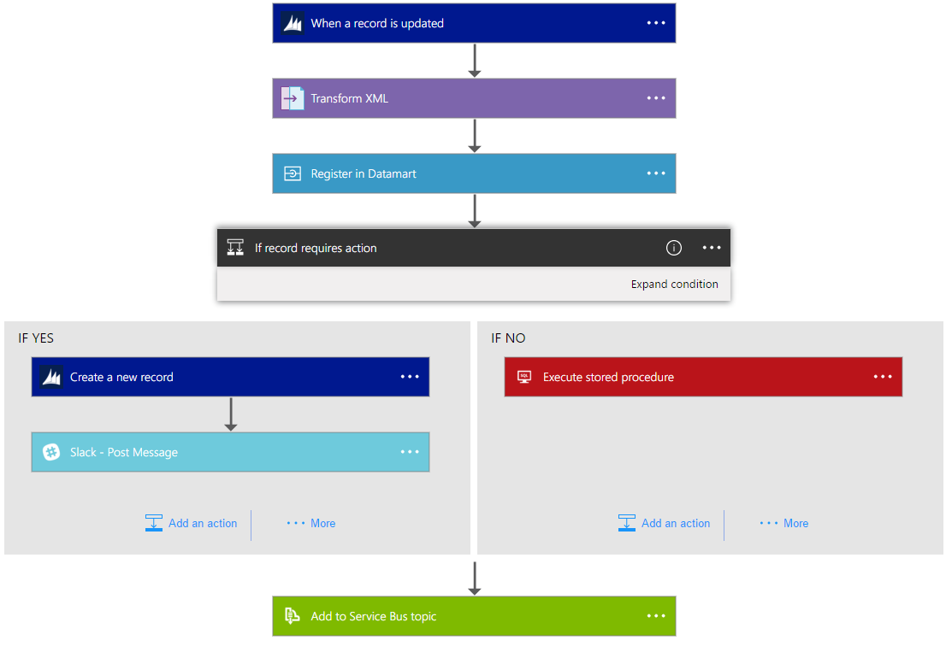
Logic Apps is Powerful Integration
Faster integration using innovative Visual Designer
Easy workflow creation with triggers and actions
Mashup applications, data and services
Built for mission critical Enterprise Integration
Create, deploy, manage and monitor

Slide 3



Logic Apps is Serverless Technology
Reduced DevOps
Faster Time To Market
Micro-billing
{ }
$
$
Event-driven scale
Abstraction of servers
Rapid
development
Focus on business logic
Per action
billing
Reduce
costs

Slide 4
I wow people by doing complex things - in minutes.
Logic Apps

Slide 5
Logic Apps is Connected
Cloud APIs and platform functionality
Nearly 200 out of box connectors
Hosted and managed within the platform
Scales to meet your needs
First class designer experience
Rapid development
API connections
Authenticate once and reuse
Differentiate connection configuration
Simple to deploy
Portal experience for managing API Connections

Slide 6
SaaS
Logic Apps is Connected
10to8
Act!
Adobe Creative Cloud
Adobe Sign
appFigures
Amazon Redshift
Asana
AWeber
Azure Active Directory
Azure API Management
Azure App Services
Azure Application Insights
Azure Automation
Azure Cognitive Services
Content Moderator
Custom Vision
Face API
LUIS
QnA Maker
Text Analytics
Video Indexer
Vision API
Azure Data Lake Store
Azure Document DB
Azure Event Grid
Azure Event Grid Publish
Azure Event Hubs
Azure Files
Azure Functions
Azure Log Analytics
Azure Log Analytics Data Collection
Azure Machine Learning
Azure Resource Manager
Azure Service Bus
Azure SQL
Azure SQL Data Warehouse
Azure Storage Blob
Azure Storage Queues
Azure Storage Tables
Basecamp2&3
Benchmark Email
Bing Maps
Bing Search
BitBucket
Bitly
Bizzy
Blogger
Box
Buffer
Calendly
Campfire
CapsuleCRM
Chatter
Cognito Forms
Common Data Service
Disqus
DocFusion365
DocParser
DocuSign
Dropbox
Dynamics CRM Online
Dynamics CRM Service Bus
Dynamics for Financials
Dynamics for Operations
Dynamics NAV
Easy Redmine
Elastic Forms
Enadoc
Eventbrite
Facebook
FlowForma
FreshBooks
Freshdesk
FreshService
GitHub
Gmail
Google Calendar
Google Contacts
Google Drive
Google Sheets
Google Tasks
GoTo Meeting
GoTo Training
GoTo Webinar
Harvest
HelloSign
HipChat
Impala
Infusionsoft
Inoreader
Insightly
Instagram
Instapaper
Intercom
JIRA
JotForm
LeanKit
LinkedIn
LiveChat
MailChimp
Mandrill
Microsoft Forms
Microsoft Kaizala
Microsoft StaffHub
Microsoft Teams
Microsoft Translator
Medium
MSN Weather
Muhimbi PDF
Nexmo
Office 365 Groups
Office 365 Outlook
Office 365 Users
Office 365 Video
OneDrive
OneDrive for Business
OneNote
Outlook.com
Outlook Customer Manager
Outlook Tasks
Paylocity
PagerDuty
Parserr
Pinterest
Pipedrive
Pitney Bowes Data Validation
Pivotal Tracker
Planner
Plivo
Power BI
Project Online
Redmine
SafetyCulture
Salesforce
Salesforce Chatter
SendGrid
ServiceNow
SharePoint Online
Skype for Business
Slack
SmartSheet
SparkPost
StaffHub
Stripe
Survey Monkey
Teamwork
Teradata
Todoist
Toodledo
Trello
Twilio
Twitter
Typeform
UserVoice
Vimeo
VS Team Services
Webmerge
Wordpress
Workday HCM
Wunderlist
Yammer
YouTube
Zendesk
Cloud APIs and platform functionality
Nearly 200 out of box connectors
Hosted and managed within the platform
Scales to meet your needs
First class designer experience
Rapid development
API connections
Authenticate once and reuse
Differentiate connection configuration
Simple to deploy
Portal experience for managing API Connections
XML & EDI
Protocols/Native
Hybrid
XML Validation
Transform XML (+Mapper)
Flat File Encode
Flat File Decode
X12
EDIFACT
AS2
Int Account Artifact Lookup
HTTP, HTTPS
HTTP Webhook
FTP, SFTP
SMTP
RSS
Compose, Parse JSON
Query, Join, Table, Select
Schedule, Wait
Variables
Terminate
Workflow
BizTalk Server
File System
IBM DB2
Informix
Oracle DB
MySQL
PostgreSQL
SharePoint Server
SQL Server
SAP
Teradata
Websphere MQ

Slide 7
I can connect to anything!
Logic Apps

